Slide 1
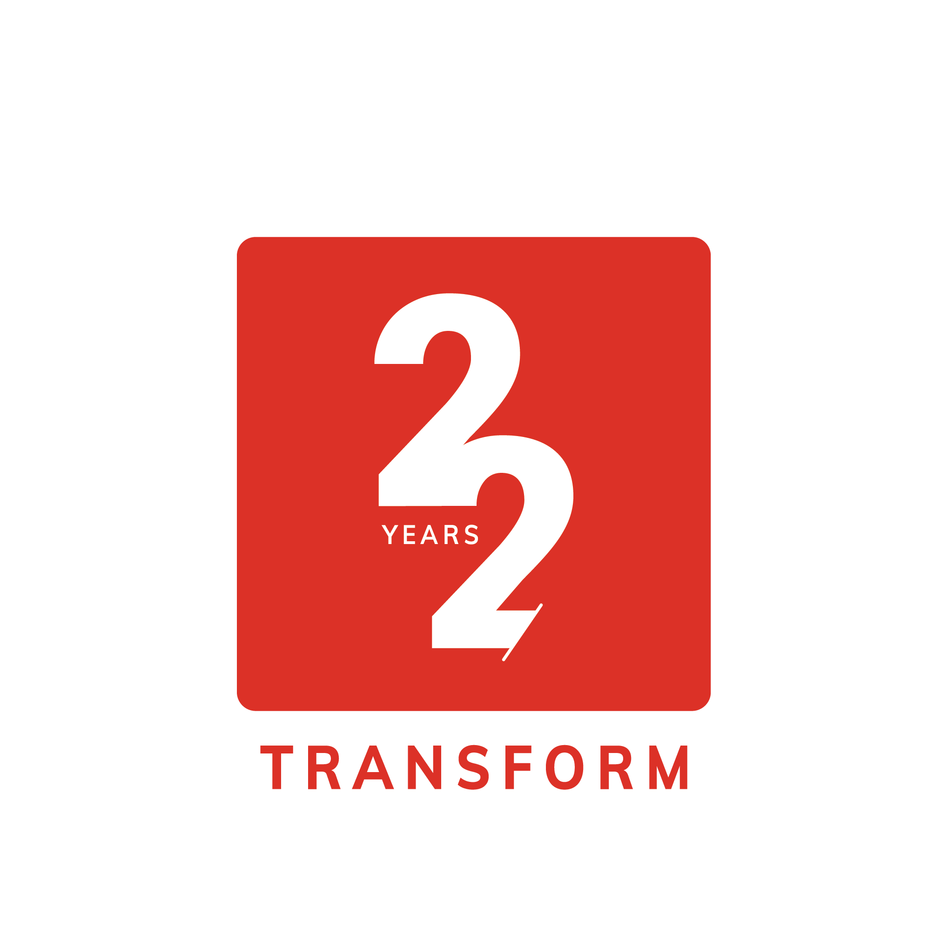

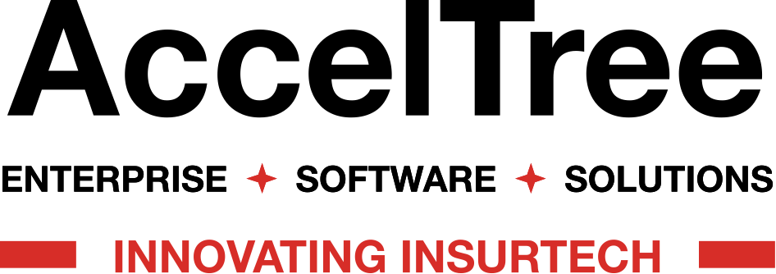

Slide 2

Application of AI in
Leads Management System

Slide 3
Agenda
1. Overview of Lead Management System
2. Role of AI in Lead Management System
3. Automated Lead Scoring System
4. Benefits of Leads Management System
5. Forecasting Lead Conversion System
6. Differences Between Standard LMS Vs. AI-Powered LMS
7. Advantages of AI in Lead Management System

Slide 4

Overview of Lead Management System
Current Challenges
Managing leads can be complex due to data overload, ineffective communication, and inconsistent follow- up strategies, hindering potential conversions and growth.
Traditional vs.
Al-based Systems
Definition & Importance
Lead management systems automate the process of capturing, tracking, and managing leads. They are essential for converting prospects into customers efficiently and effectively.
Traditional lead management relies heavily on manual data entry and analysis, while Al- based systems utilize machine learning to enhance accuracy, streamline processes, and improve scalability.

Slide 5

Role of AI in Lead Management System
Al algorithms can process vast amounts of data rapidly, providing deeper insights into lead behavior and preferences, enabling more informed decisions.
Enhanced Data Analysis
By analyzing historical data, Al can forecast future lead behaviors and outcomes, allowing businesses to prioritize and allocate resources more effectively.
Predictive Analysis
Al automates routine decisions in lead quallfication and prioritization, reducing human error and freeing up sales teams to focus on high- value interactions.
Desicion-Making Automation
Al tailors communications and offers to individual leads based on their interactions, preferences and behaviors, enhancing engagement and improving conversion rate.
Personalized Customer Experience

Slide 6


Automated Lead Scoring
Machine learning models analyze historical data to identify patterns that predict lead conversion, allowing for a more accurate scoring mechanism that improves over time.
Predictive analytics utilizes data mining, statistics, and modeling techniques to forecast future lead behaviors and potentia success, aiding in prioritization of sales efforts.
Machine Learning Models
Predictive Analysis

Slide 7



Benefits of Leads Management System
Cost Effectiveness
Improved Accuracy
Increased Efficiency
Automation in lead management minimizes the risk of human errors in data entry and analysis, leading to more reliable decision- making and improved data integrity.
Al systems can analyze a vast array of lead data automatically, scoring them based on predefined criteria, which helps prioritize high- quality leads for sales teams.
Automated email campaigns deliver targeted messages at optimal times, increasing interaction rates and nurturing leads through personalized content tailored to their interests.

Slide 8


Forecasting Lead Conversion
Sales Funnel Predictions
Conversion Rate Optimization
Sales funnel predictions involve using historical data and analytical to forecast the flow of Leads through various stages, adding in resource allocation and sales strategies.
This process focuses on analyzing conversion metrics to enhance strategies that Increase the percentage of leads that ultimately become customers, ensuring a more etriclent sales pipeline.

Slide 9


Differences Between Standard LMS Vs. AI-Powered LMS
Standard LMS
AI-powered LMS
Typically relies on static content delivery with limited adaptability to individual learners. It requires significant manual input for content creation, assessment grading, and administrative tasks.
Utilizes Machine Learning algorithms to automatically adapt content to each learner's needs, automate administrative tasks, and provide in-depth analytics and insights. The result is a more dynamic, efficient, and effective learning environment.

Slide 10

Advantages of AI in Leads Management System
90
Enhanced customer insights
85
Increased Efficiency
75
Better Lead Scoring
30
Improved Conversion Rates

Slide 11
Thank You!

